Slide 1

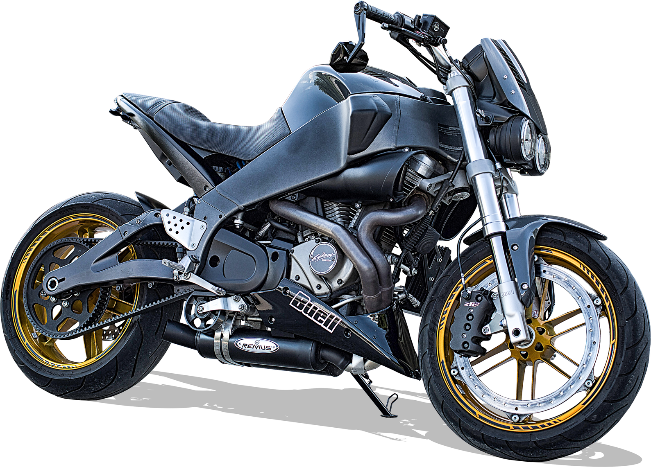


Bike dataset
Michea C.
Julian C.
Andrea M.

Slide 2

Dataset
Analysis
End
Dataset
From Kaggle, scraped from Bikez.com
~ 38'000 rows, 77 columns
02

Slide 3
Dataset
Analysis
End
How is our dataset structured ?
Each row, is a different bike model:
The set contains the price, but not any indications on sales for that model
 | Model | Manufacturer | Year | HP | Displacement_cc | Engine type | Top_speed_kmh
 | BMW F 750 GS | BMW | 2021.0 | 77.0 | 853.0 | Twin, four-stroke | 190.0
03

Slide 4
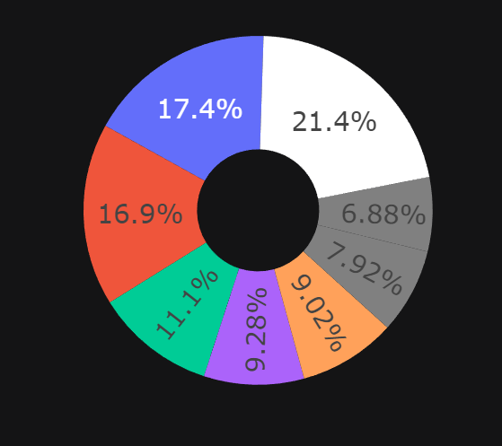
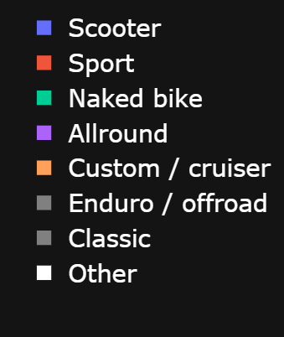
Dataset
Analysis
End
Models by type of bike
04

Slide 5
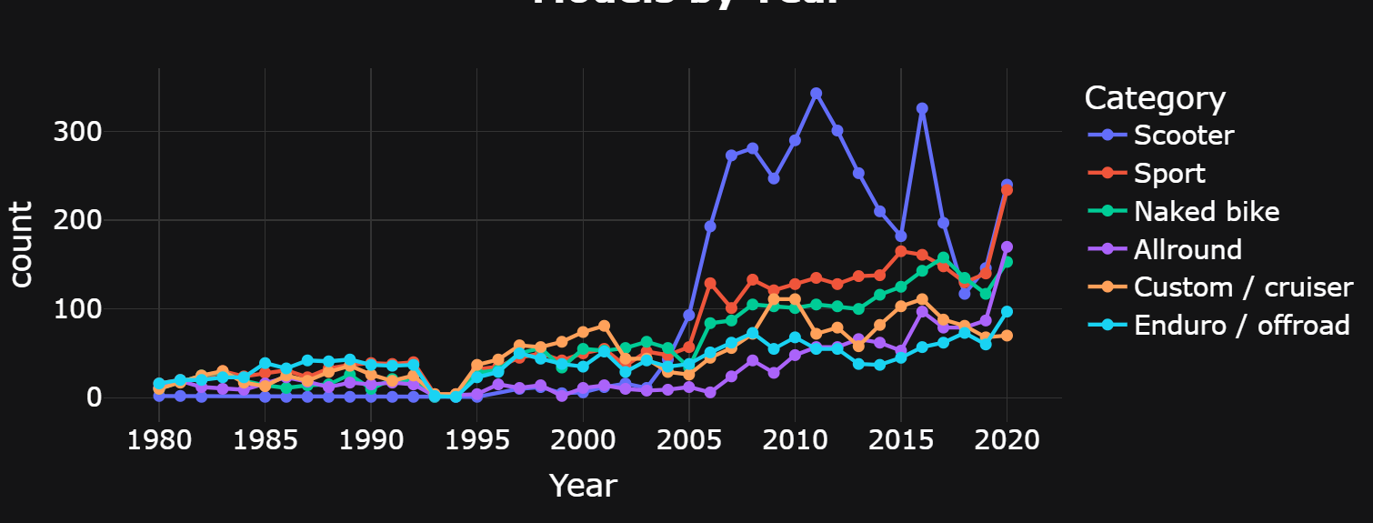
Dataset
Analysis
End
Models by Year
05

Slide 6
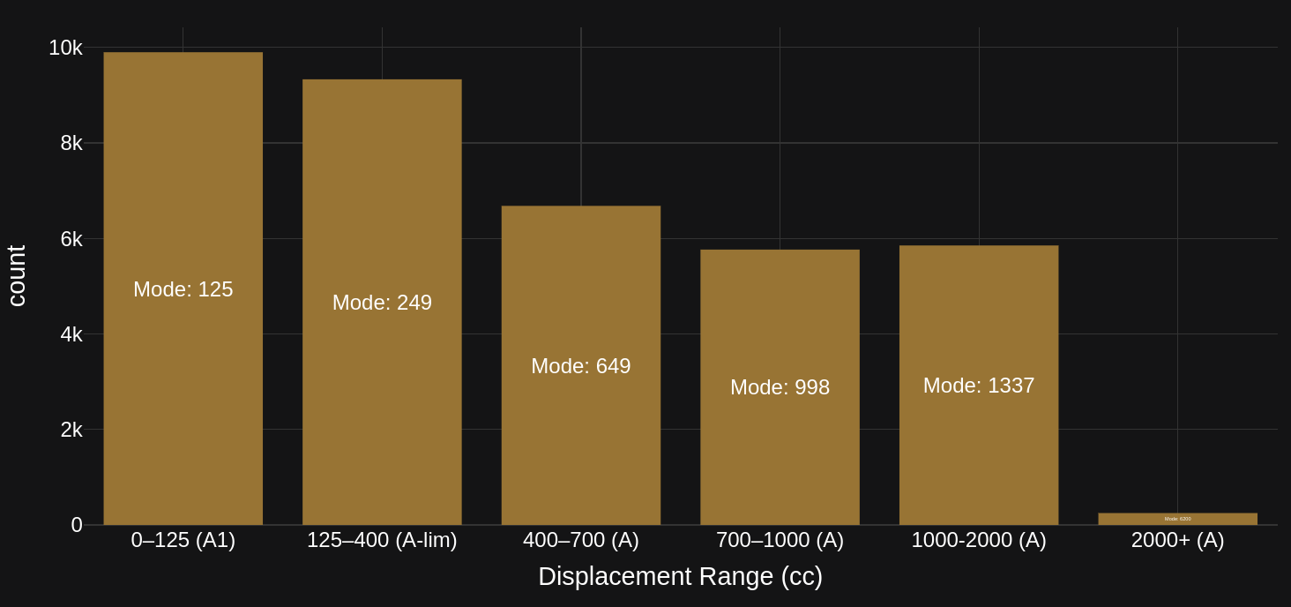
Dataset
Analysis
End
Count of bikes per cc category
Mode: 6200
05

Slide 7
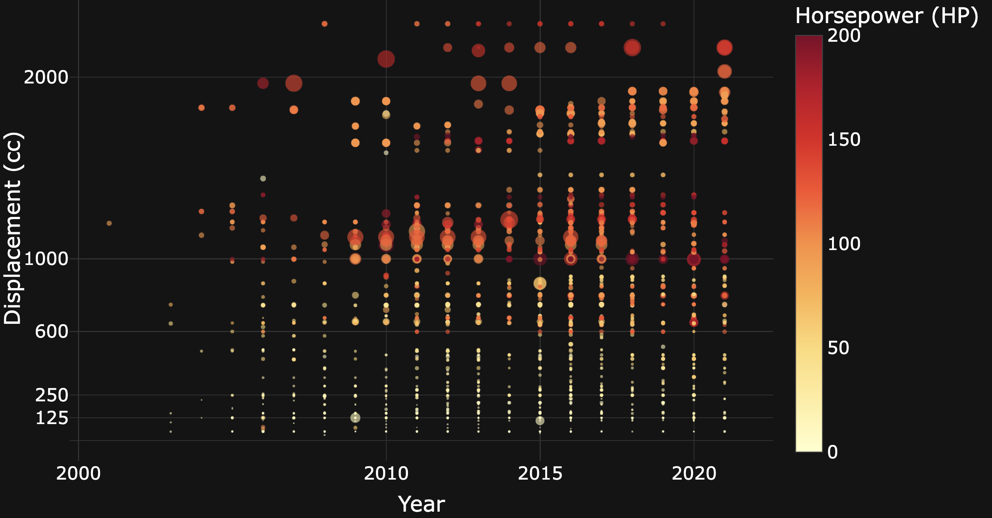
Dataset
In progress
End
Evolution of Bike HP and CC Over the Years
06
Notes:
Mic

Slide 8
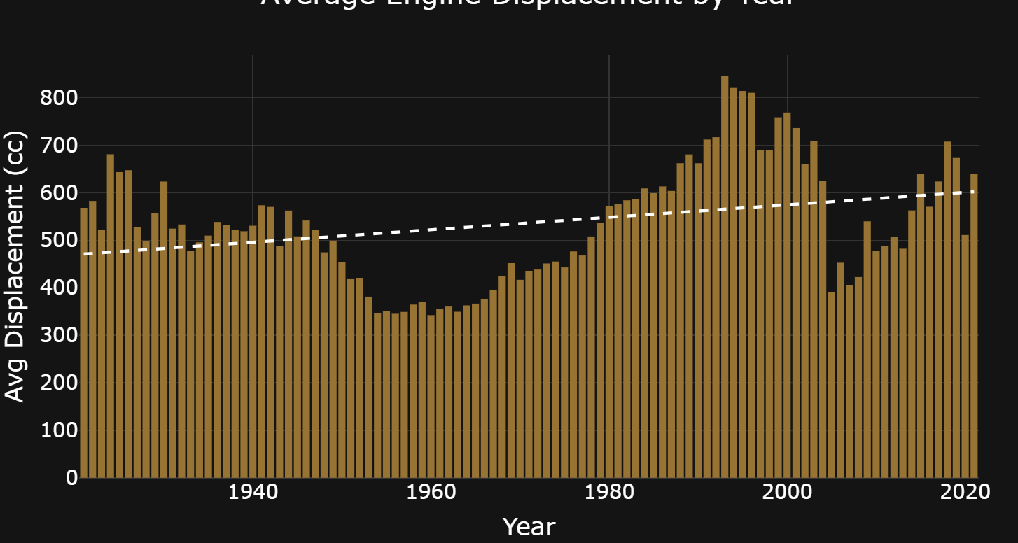
Dataset
In progress
End
Displacement behaves like a “trend”
But generally, increases
06
Notes:
Mic

Slide 9
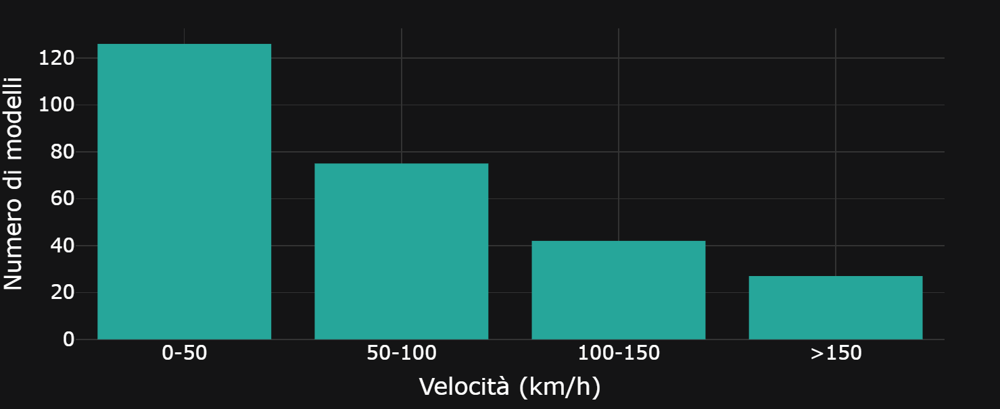
Dataset
In progress
End
Majority of electric bikes are slow
06
Notes:
Mic

Slide 10
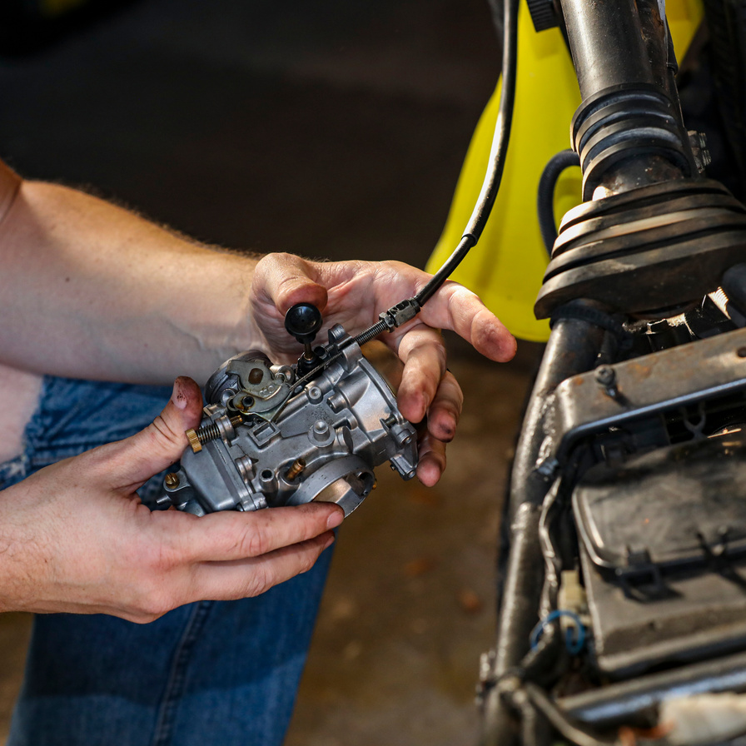


Dataset
Analysis
End
Planned analysis
Analysis on Brands grouped from models
Analysis on type of fuel and green alternative
Technical and nontechnical analysis
07

